Slide 1
CPE 221: Computer Organization
07 ARM Stacks and Frames
rahul.bhadani@uah.edu

Slide 2
Stacks
Generally speaking, the Stack is a memory region within the program/process. This part of the memory gets allocated when a process is created. We use Stack for storing temporary data such as local variables of some function, environment variables which helps us to transition between the functions, etc.

Slide 3
PUSH and POP
We interact with the stack using PUSH and POP instructions.
PUSH and POP are aliases to some other memory related instructions rather than real instructions, but we use PUSH and POP for simplicity reasons.

Slide 4
Growing a Stack
When we say that Stack grows, we mean that an item (32 bits of data) is put on to the Stack. The stack can grow UP (when the stack is implemented in a Descending fashion) or DOWN (when the stack is implemented in a Ascending fashion).

Slide 5
Stack Pointer (SP)
The actual location where the next (32 bit) piece of information will be put is defined by the Stack Pointer, or to be precise, the memory address stored in the SP register.

Slide 6
How does Stack Pointer (SP) work?
The address could be pointing to the current (last) item in the stack or the next available memory slot for the item.
If the SP is currently pointing to the last item in the stack (Full stack implementation) the SP will be decreased (in case of Descending Stack) or increased (in case of Ascending Stack) and only then the item will placed in the Stack.
If the SP is currently pointing to the next empty slot in the Stack, the data will be first placed and only then the SP will be decreased (Descending Stack) or increased (Ascending Stack).

Slide 7
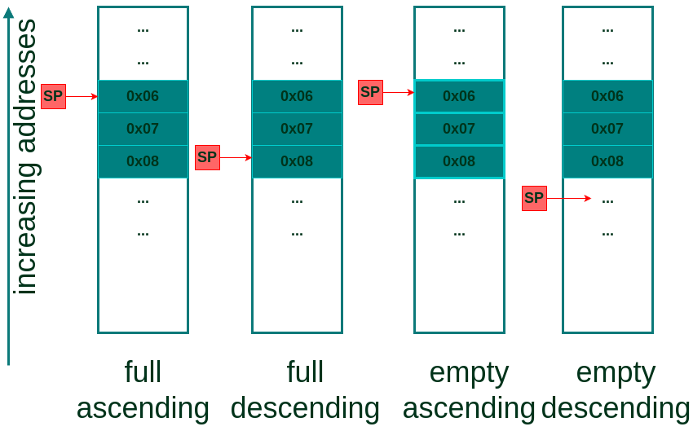
Stack Implementation Example

Slide 8
Different Stack Implementation
As a summary of different Stack implementations we can use the following table which describes which Store Multiple/Load Multiple instructions are used in different cases.
In our examples, we will use the Full descending Stack.
Stack Type | Store | Load
Full descending | STMFD (STMDB, Decrement Before) | LDMFD (LDM, Increment after)
Full ascending | STMFA (STMIB, Increment Before) | LDMFA (LDMDA, Decrement After)
Empty descending | STMED (STMDA, Decrement After) | LDMED (LDMIB, Increment Before)
Empty ascending | STMEA (STM, Increment after) | LDMEA (LDMDB, Decrement Before)

Slide 9
Example
.global _start
_start:
MOV R0, #2 /* set up R0 */
PUSH {R0} /* save R0 onto the stack */
MOV R0, #3 /* overwrite R0 */
POP {R0} /* restore R0 to it's initial state */
BX LR /* finish the program */
done: B done

Slide 10
Example 1
Assume, at the beginning, the Stack Pointer points to address 0xbefff6f8, which represents the last item in the Stack. At this moment, we see that it stores some value (just an example):
0xbefff6f8: 0xb6fc7000

Slide 11
Example 1 Continues
After executing the first (MOV) instruction, nothing changes in terms of the Stack.
When we execute the PUSH instruction, the following happens:
First, the value of SP is decreased by 4 (4 bytes = 32 bits).
Then, the contents of R0 are stored to the new address specified by SP.
When we now examine the updated memory location referenced by SP, we see that a 32 bit value of integer 2 is stored at that location:
0xbefff6f4: 0x00000002

Slide 12
Example 1 Continues
The instruction (MOV R0, #3) in our example is used to simulate the corruption of the R0.
We then use POP to restore a previously saved value of R0.
When the POP gets executed, the following happens:
First, 32 bits of data are read from the memory location (0xbefff6f4) currently pointed by the address in SP.
Then, the SP register’s value is increased by 4 (becomes 0xbefff6f8 again).
The register R0 contains integer value 2 as a result.

Slide 13
Stacks in Functions

Slide 14
Function Takes Advantage of Stacks
Functions take advantage of Stack for saving local variables, preserving register state, etc.
To keep everything organized, functions use Stack Frames, a localized memory portion within the stack which is dedicated for a specific function.

Slide 15
Stack Frame
A stack frame gets created in the prologue (more about this in the next section) of a function.

Slide 16
Stack Frame
The Frame Pointer (FP) is set to the bottom of the stack frame and then stack buffer for the Stack Frame is allocated.
The stack frame (starting from it’s bottom) generally contains the return address (previous LR), previous Frame Pointer, any registers that need to be preserved, function parameters (in case the function accepts more than 4), local variables, etc.
While the actual contents of the Stack Frame may vary, the ones outlined before are the most common. Finally, the Stack Frame gets destroyed during the epilogue of a function.

Slide 17
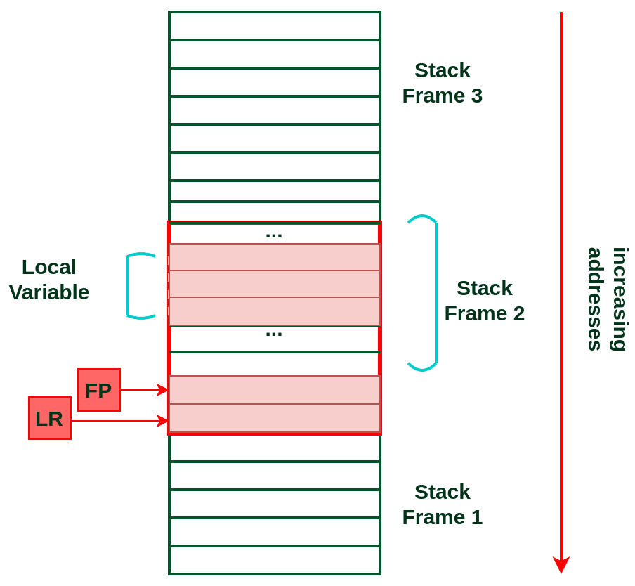
Illustration of a Stack Frame within the Stack:

Slide 18
Example 2
int main() {
int res = 0;
int a = 1;
int b = 2;
res = max(a, b);
return res;
}
int max(int a,int b) {
do_nothing();
if(a<b) { return b; }
else { return a; }
}
int do_nothing() { return 0; }

Slide 19
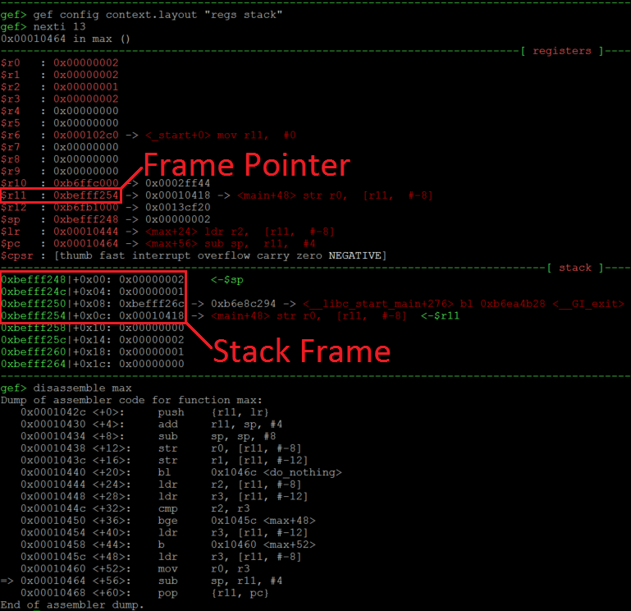
Example 2 Continues …
We are about to leave the function max (see the arrow in the disassembly at the bottom).
At this state, the FP (R11) points to 0xbefff254 which is the bottom of our Stack Frame.
This address on the Stack (green addresses) stores 0x00010418 which is the return address (previous LR).
4 bytes above this (at 0xbefff250) we have a value 0xbefff26c, which is the address of a previous Frame Pointer.
The 0x1 and 0x2 at addresses 0xbefff24c and 0xbefff248 are local variables which were used during the execution of the function max.
So the Stack Frame which we just analyzed had only LR, FP and two local variables.

Slide 20
Example: Swap – Pass by Reference
void swap (int*, int*);
void main (void)
{
int x = 2, y = 3;
swap (&x, &y); /* swap x and y */
}
void swap (int *a, int *b)
{
int temp;
temp = *a;
*a = *b;
*b = temp;
}

Slide 21
Example: Swap – Pass by Reference
MOV SP, #0x00000000 @ (0)
MOV FP, #0xFFFFFF00 @ (4)
B main @ (
swap: PUSH {FP} @ (12)
MOV FP, SP @ (16)
SUB SP, SP, #4 @ (20)
LDR R1, [FP, #4] @ get address of parameter a (24)
LDR R2, [R1] @ get value of parameter a (28)
STR R2, [FP, #-4] @ store a in temp in stack frame (32)
LDR R0, [FP, #8] @ get address of parameter b (36)
LDR R3, [R0] @ get value of parameter b (40)
STR R3, [R1] @ store parameter b in parameter a 44)
LDR R3, [FP, #-4] @ get temp from stack frame (48)
STR R3, [R0] @ store temp in b (52)
MOV SP, FP @ Collapse stack frame; restore sp (56)
POP {FP} @ (60)
MOV PC, LR @ (64)
main: PUSH {FP} @ (68)
MOV FP, SP @ (72)
SUB SP, SP, #8 @ (76)
ADR R6, y @ store y on the stack (80)
STR R6, [fp, #-4] @ store &y on the stack (84)
ADR R6, x @ (88)
STR R6, [fp, #-8] @ store &x on the stack (92)
BL swap @ (96)
MOV SP, FP @ Collapse frame; restore sp (100)
POP {FP} @ (104)
stop: B stop @ (108)
x: .word 2 @ (112)
y: .word 3 @ (116)

Slide 22
Example: Multiply_by_Adding with Subroutines
int mpy_ne(int, int)
int abs(int)
int main() {
int first = 8;
int second = -9;
int result;
result = mpy_ne(first, second);
}
int mpy_ne (int num1; int num2){
int a, b, mult;
a = abs(num1);
b = abs(num2);
mult = 0;
for (i = 0; i < a; i++)
mult = mult + b;
if (num1 < 0) mult = -mult;
if (num2 < 0) mult = -mult;
return mult;
}
int abs(int x){
if (x < 0) x = -x;
return x;
}

Slide 23
Example: Multiply_by_Adding with Subroutines
.section multiply_by_adding_wneg, “ax”
LDR R1, num1 @ Put num1 in r1.
LDR R2, num2 @ Put num2 in r2.
ADR R9, result
MOV R3, #0 @ Set r3 to 0, it will hold the result.
TEQ R1, #0 @ Compare first num to 0
BEQ done @ If first num is 0 done, result = 0.
TEQ R2, #0 @ Compare second numto 0
BEQ done @ If second numis 0, done, result = 0.
CMP R1, #0
RSBMI R4, R1, #0
CMP R2, #0
RSBMI R5, R2, #0
adding: ADD R3, R3, R5 @ Add num2.
SUBS R4, R4, #1 @ Decrement r4, the abs of num1.
BEQ adjust @ If r4 = 0, done adding, go to adjust.
B adding @ Otherwise, need to add again.
adjust: MOVS R1, R1 @ Done adding, now adjust result.
RSBMI R3, R3, #0 @ If num2 negative, negate result.
MOVS R2, R2
RSBMI R3, R3, #0 @ If num1 negative, negate result.
done: STR r3, [r9]
num1: .word -8 @ Give num1 a value
num2: .word -9 @ Give num2 a value
result: .space 4
.end

Slide 24
Prologue, Body and Epilogue of the Function
Prologue sets up the environment for the function;
Body implements the function’s logic and stores result to R0;
Epilogue restores the state so that the program can resume from where it left of before calling the function.

